Slide 1
LSDA Final Project
Name: Medvegy Gábor
Neptun: SZHNB1

Slide 2
Business Goal
What are the most important factors influencing median house prices of neighborhoods in California, and implicitly, where should one look if they want to find affordable housing there?

Slide 3
Agenda
What was the business goal?
What was done to successfully achieve the goal set?
How the architecture supports business goals?
How to measure the project’s success?
Who will benefit from the project?
How much would it cost to implement?

Slide 4
Dataset
California housing data derived from the 1990 census.
longitude
latitude
housing_median_age
total_rooms
total_bedrooms
population
households
median_income
median_house_value
ocean_proximity

Slide 5
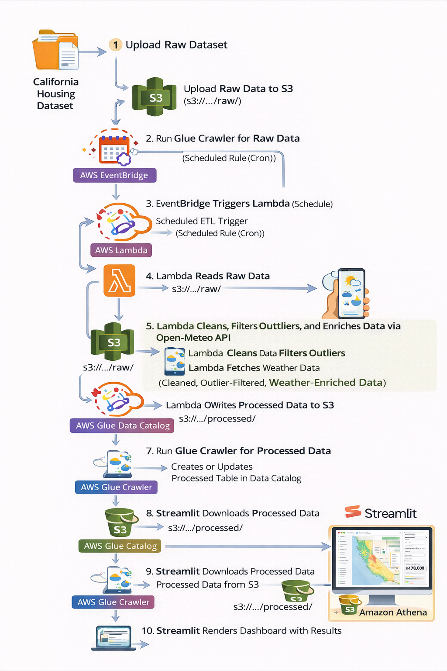
Data Pipeline & Architecture
Raw California housing data is uploaded to Amazon S3.
Amazon EventBridge triggers an AWS Lambda ETL job on a schedule.
Lambda cleans the data, handles missing values and outliers, samples the data, and enriches it with weather API data.
The processed dataset is saved back to Amazon S3.
An AWS Glue crawler catalogs the data for querying in Amazon Athena.
The final dataset is also used in a Streamlit app for visualizations and house price prediction.

Slide 6
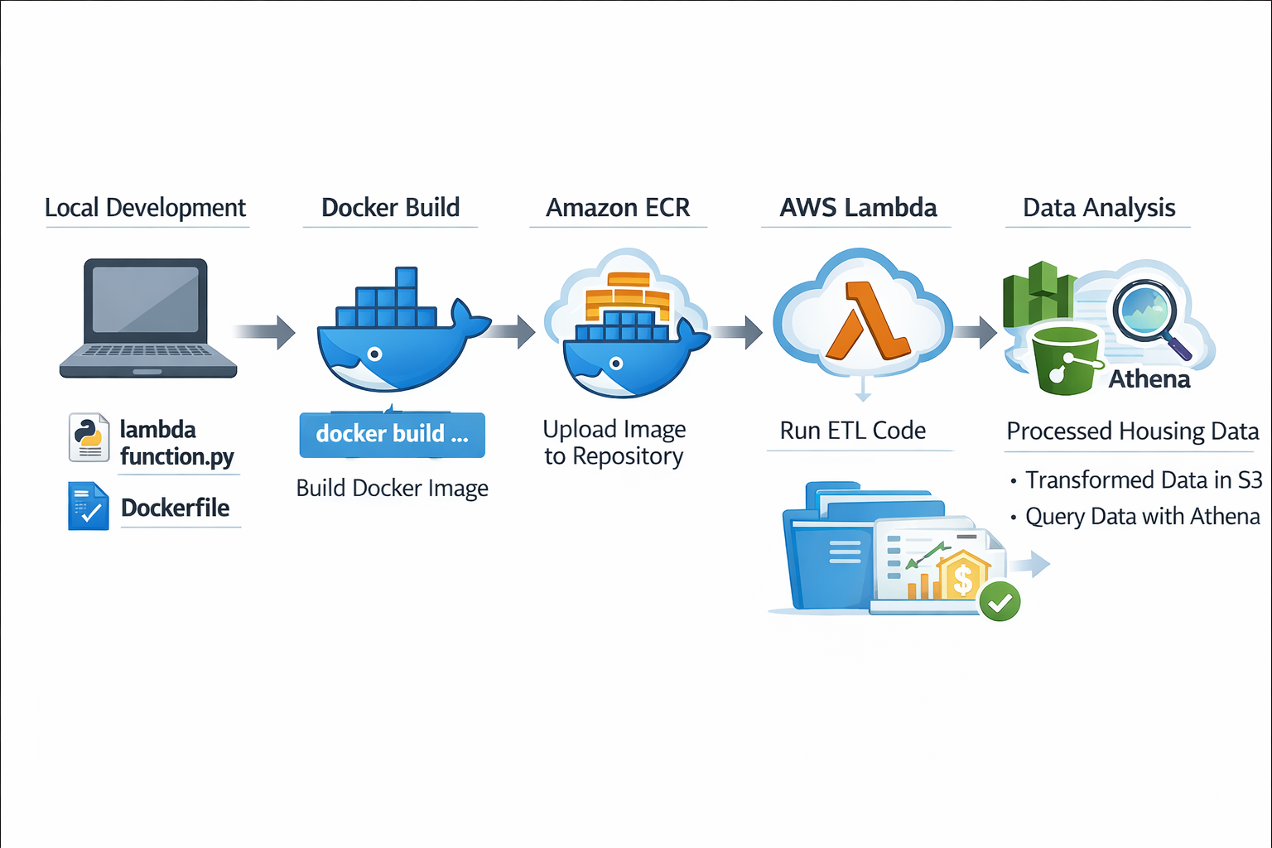
Docker
Local development: Implemented the Lambda ETL function and defined all required Python dependencies in a Dockerfile.
Docker build: Built a portable Docker image containing the ETL application and all necessary libraries.
Registry: Pushed the Docker image to a container registry (Amazon ECR) for deployment.
Deployment: Deployed and executed the container image as an AWS Lambda function.
User access: Processed data is accessed and analyzed through AWS services (S3 and Athena).

Slide 7
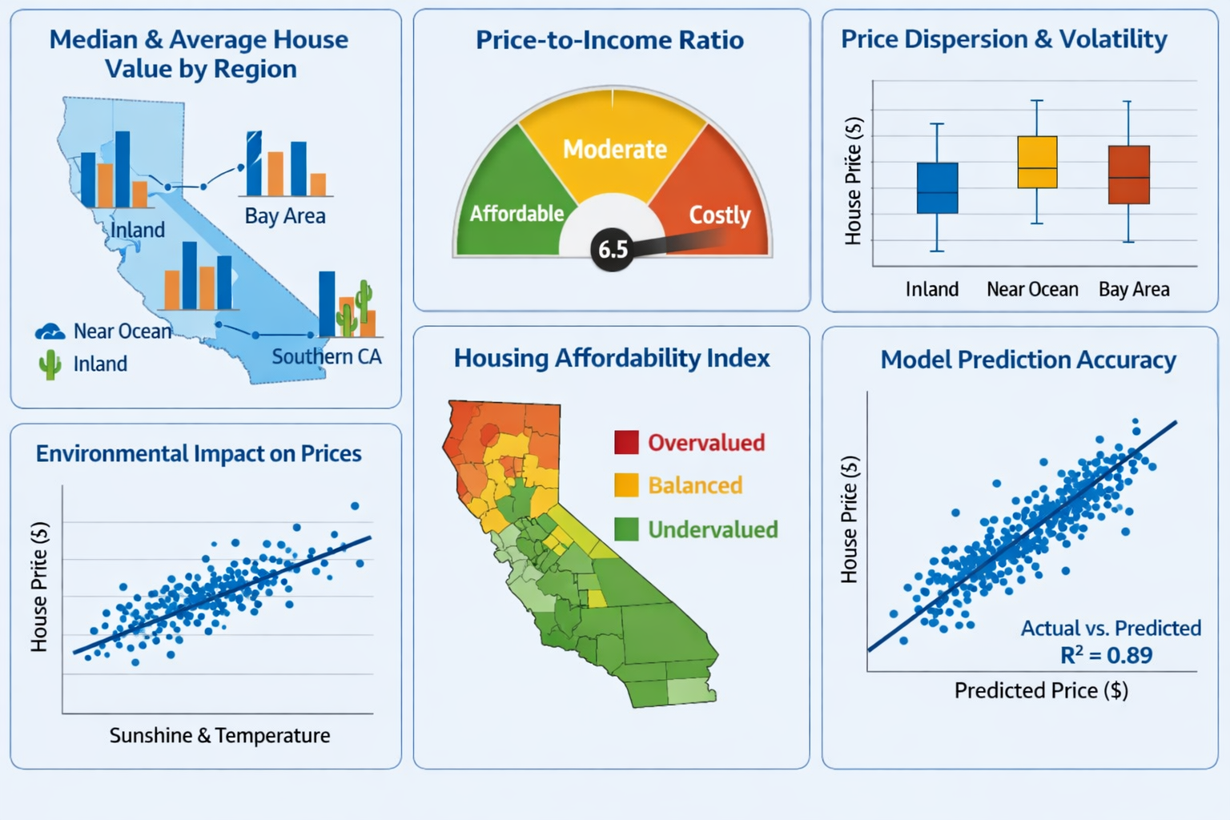
KPIs Supported by the pipeline

Slide 8
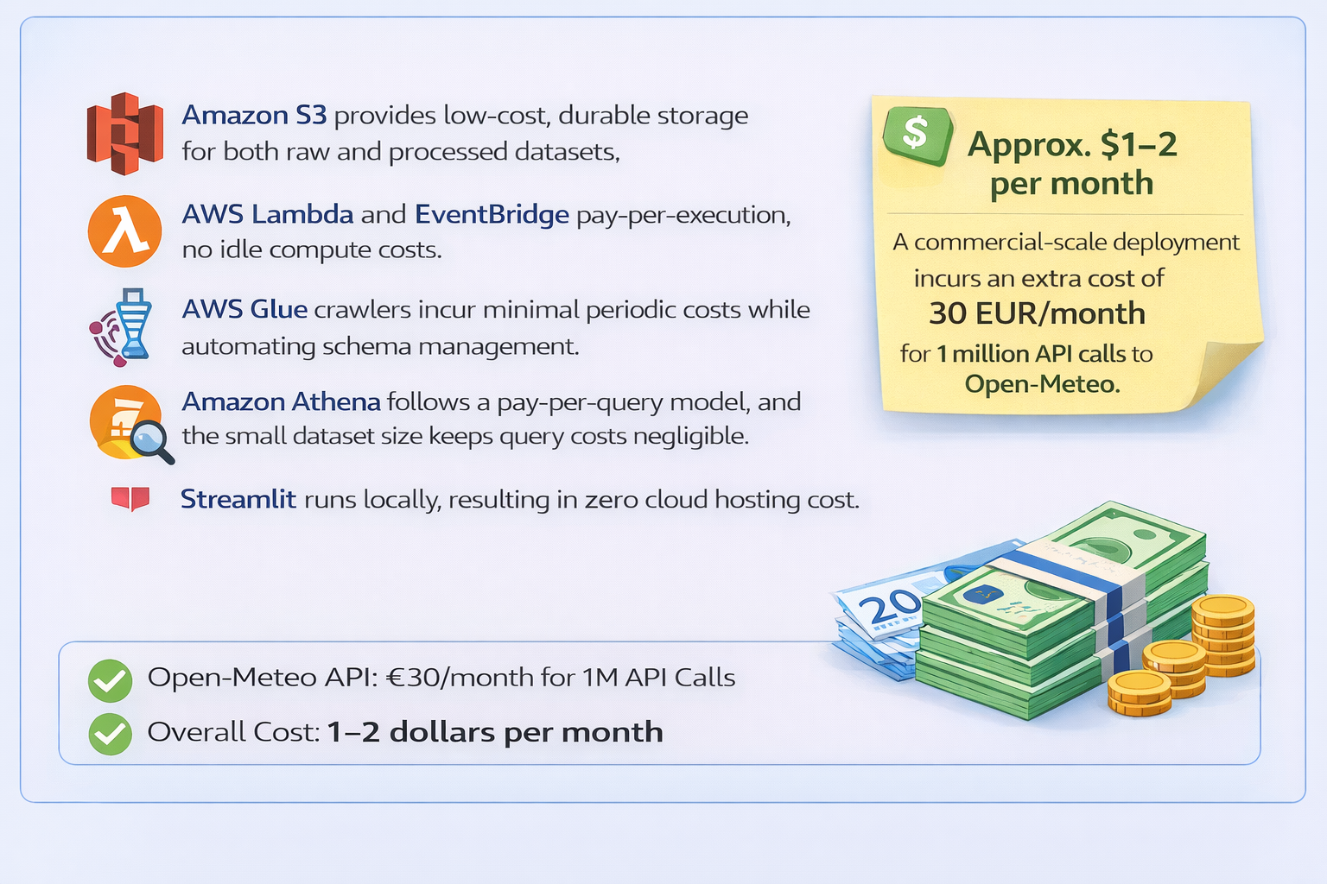
Costs

Slide 9
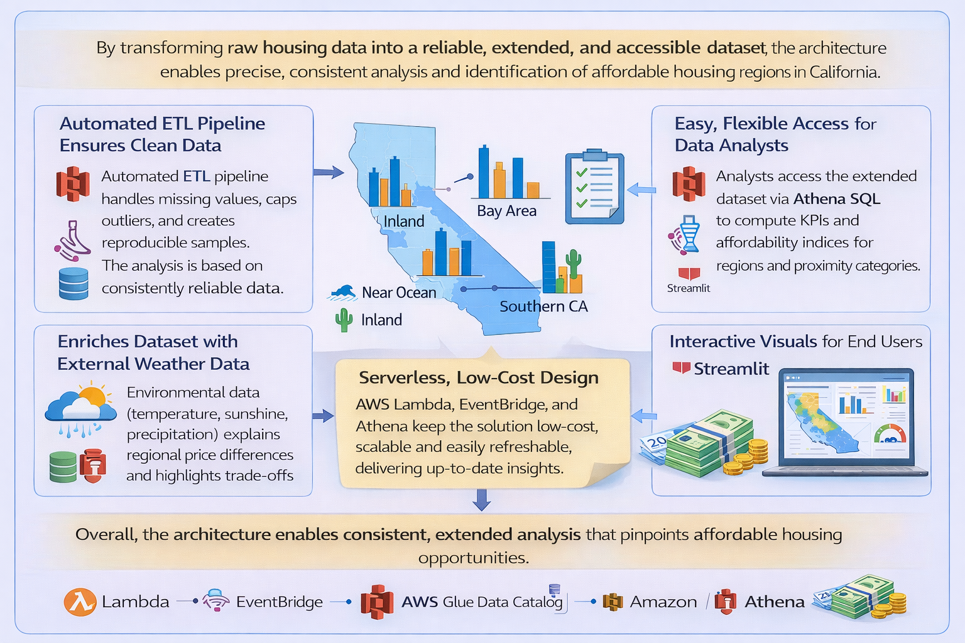
Goals Supported

Slide 10
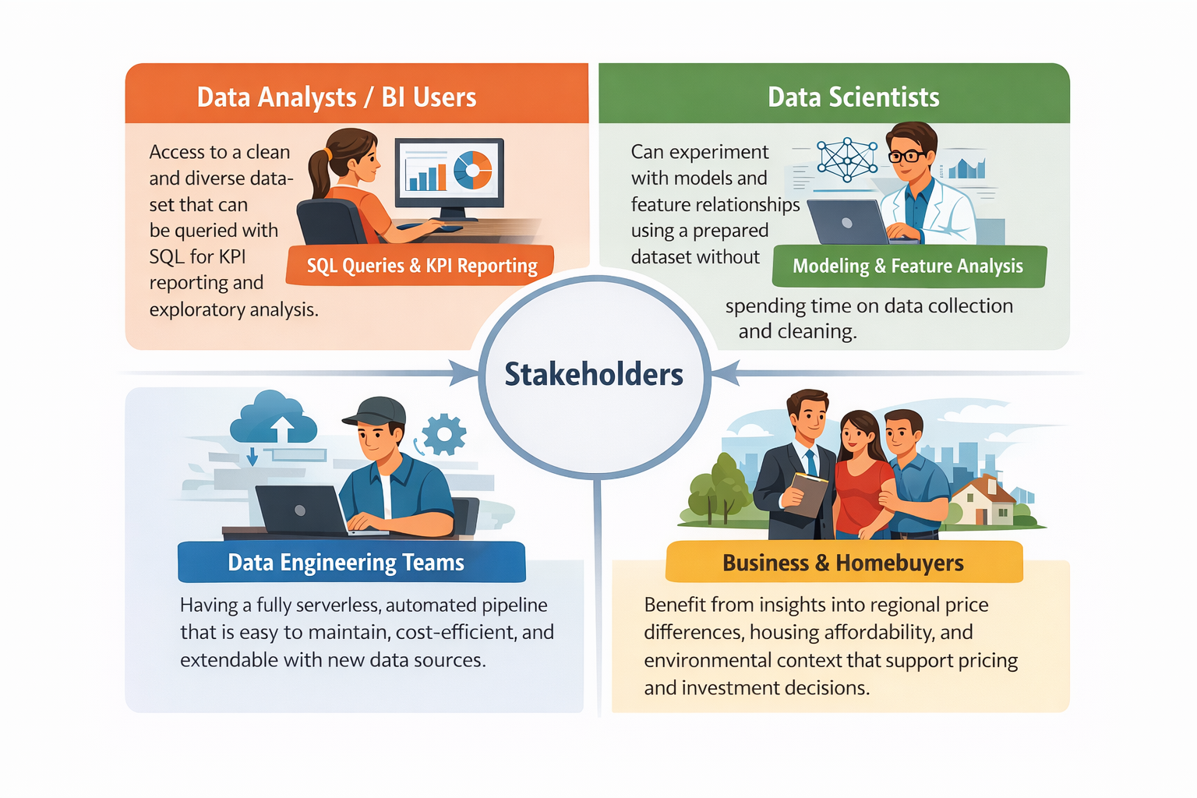
Stakeholders & Value

Slide 11
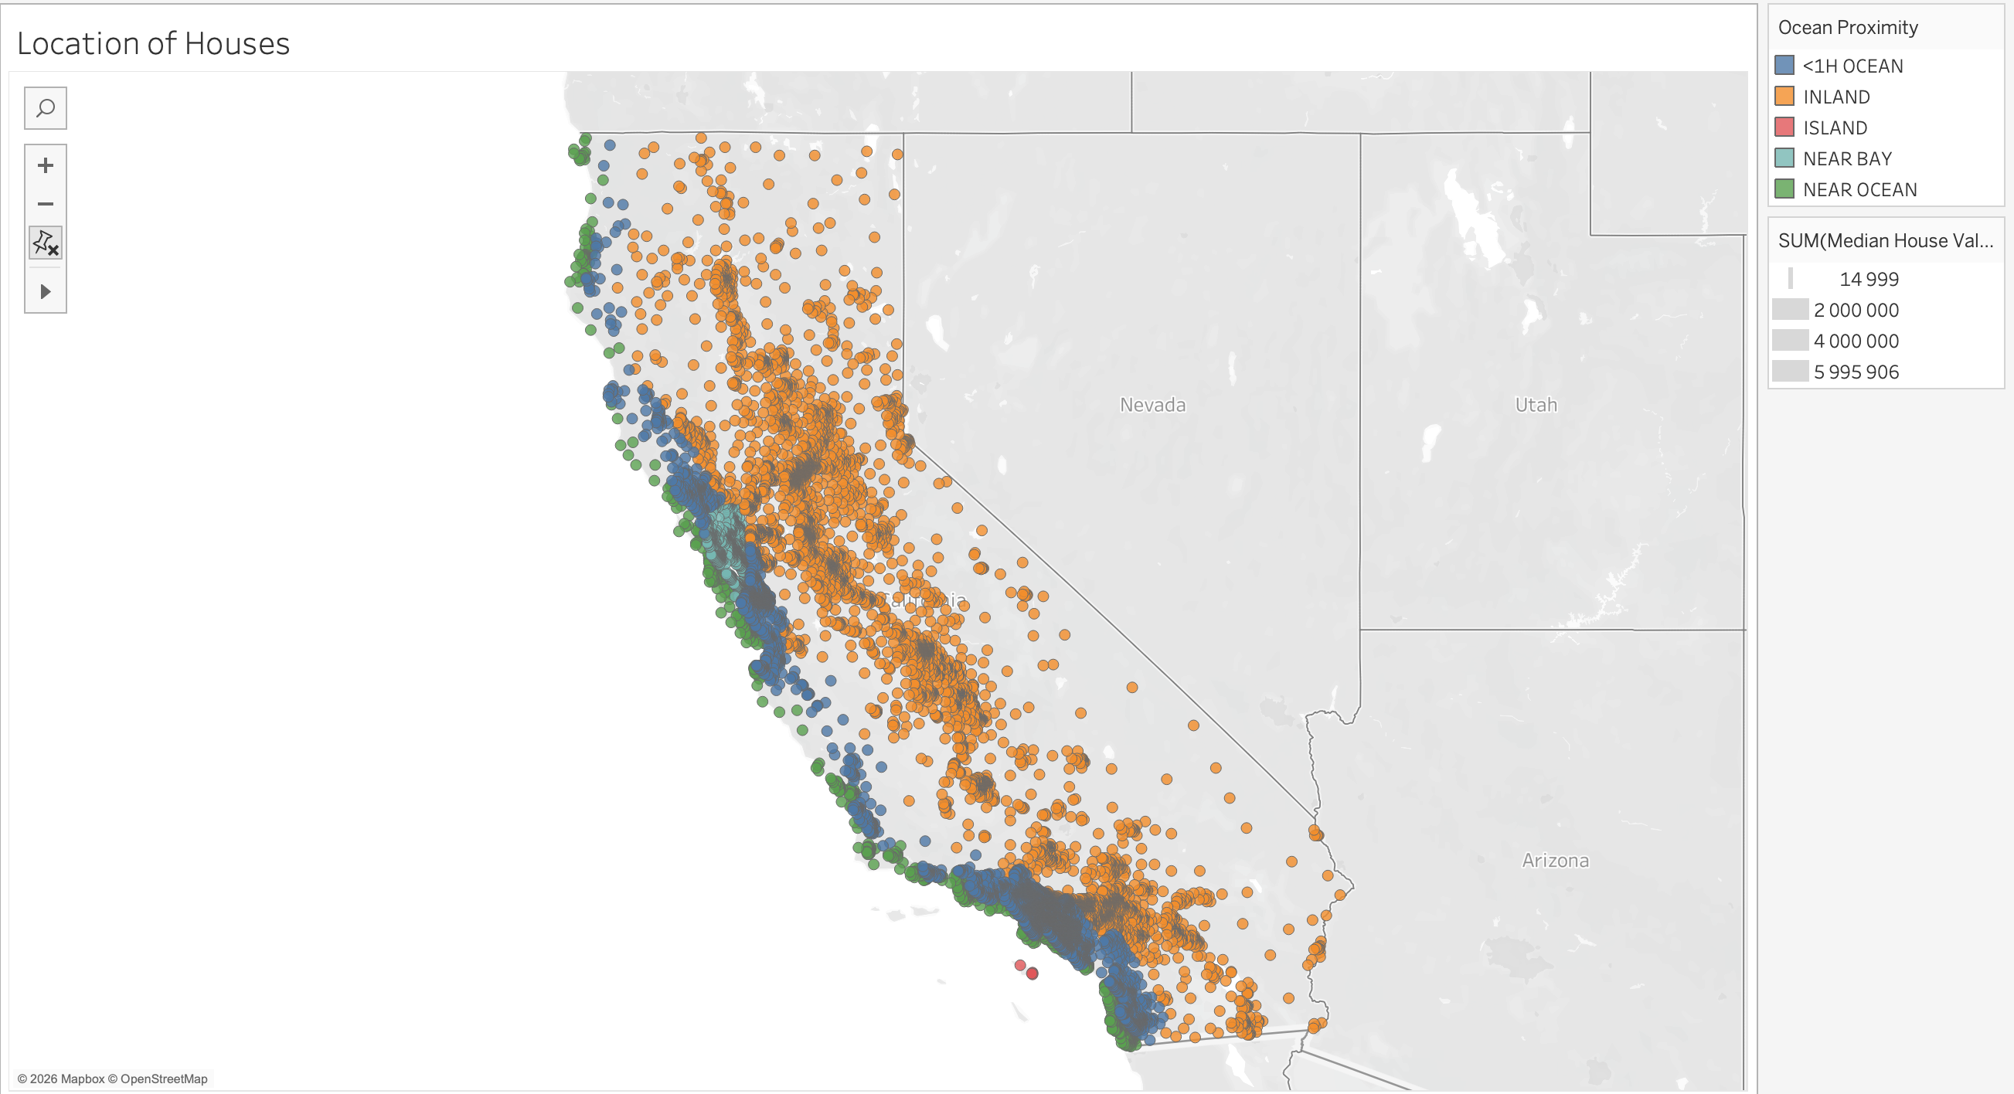
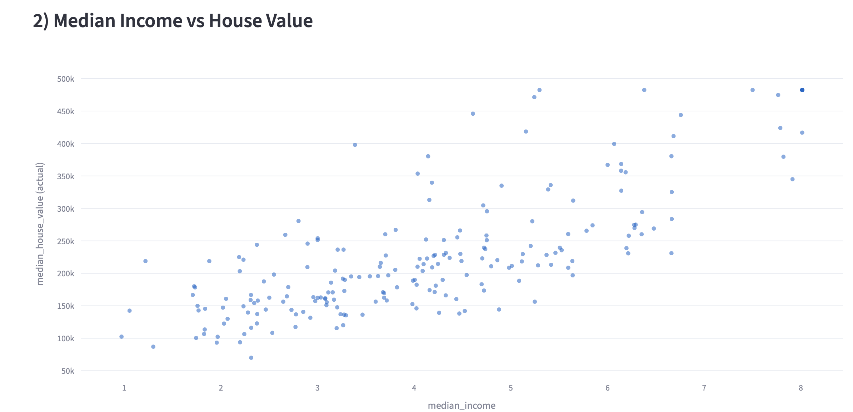
In Action

Slide 12
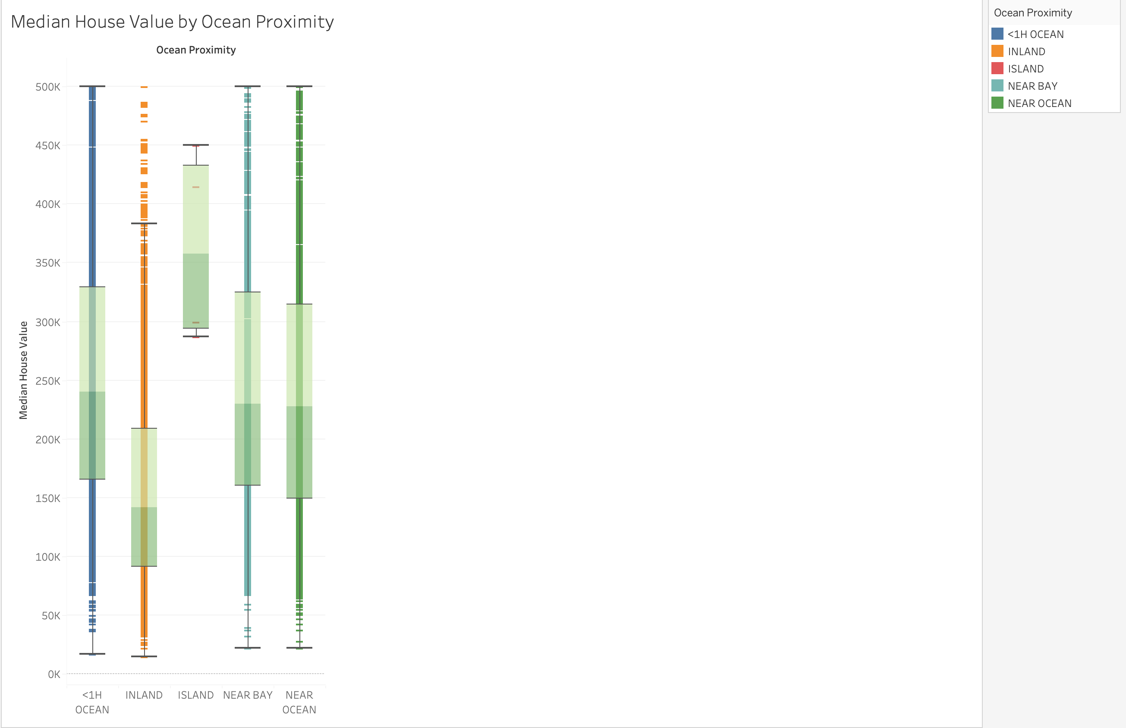
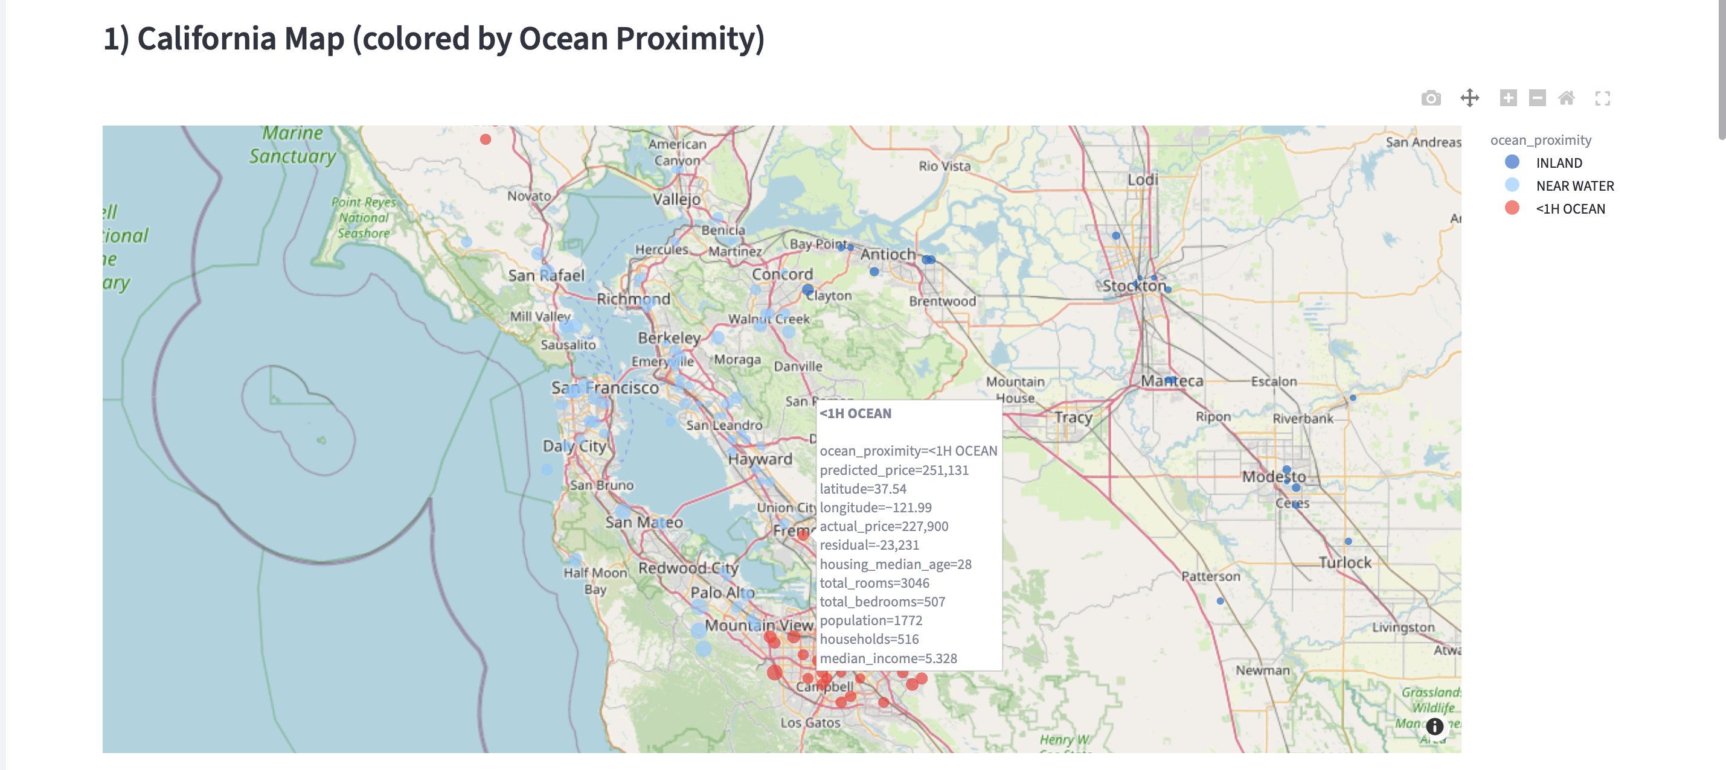
In Action

Slide 13
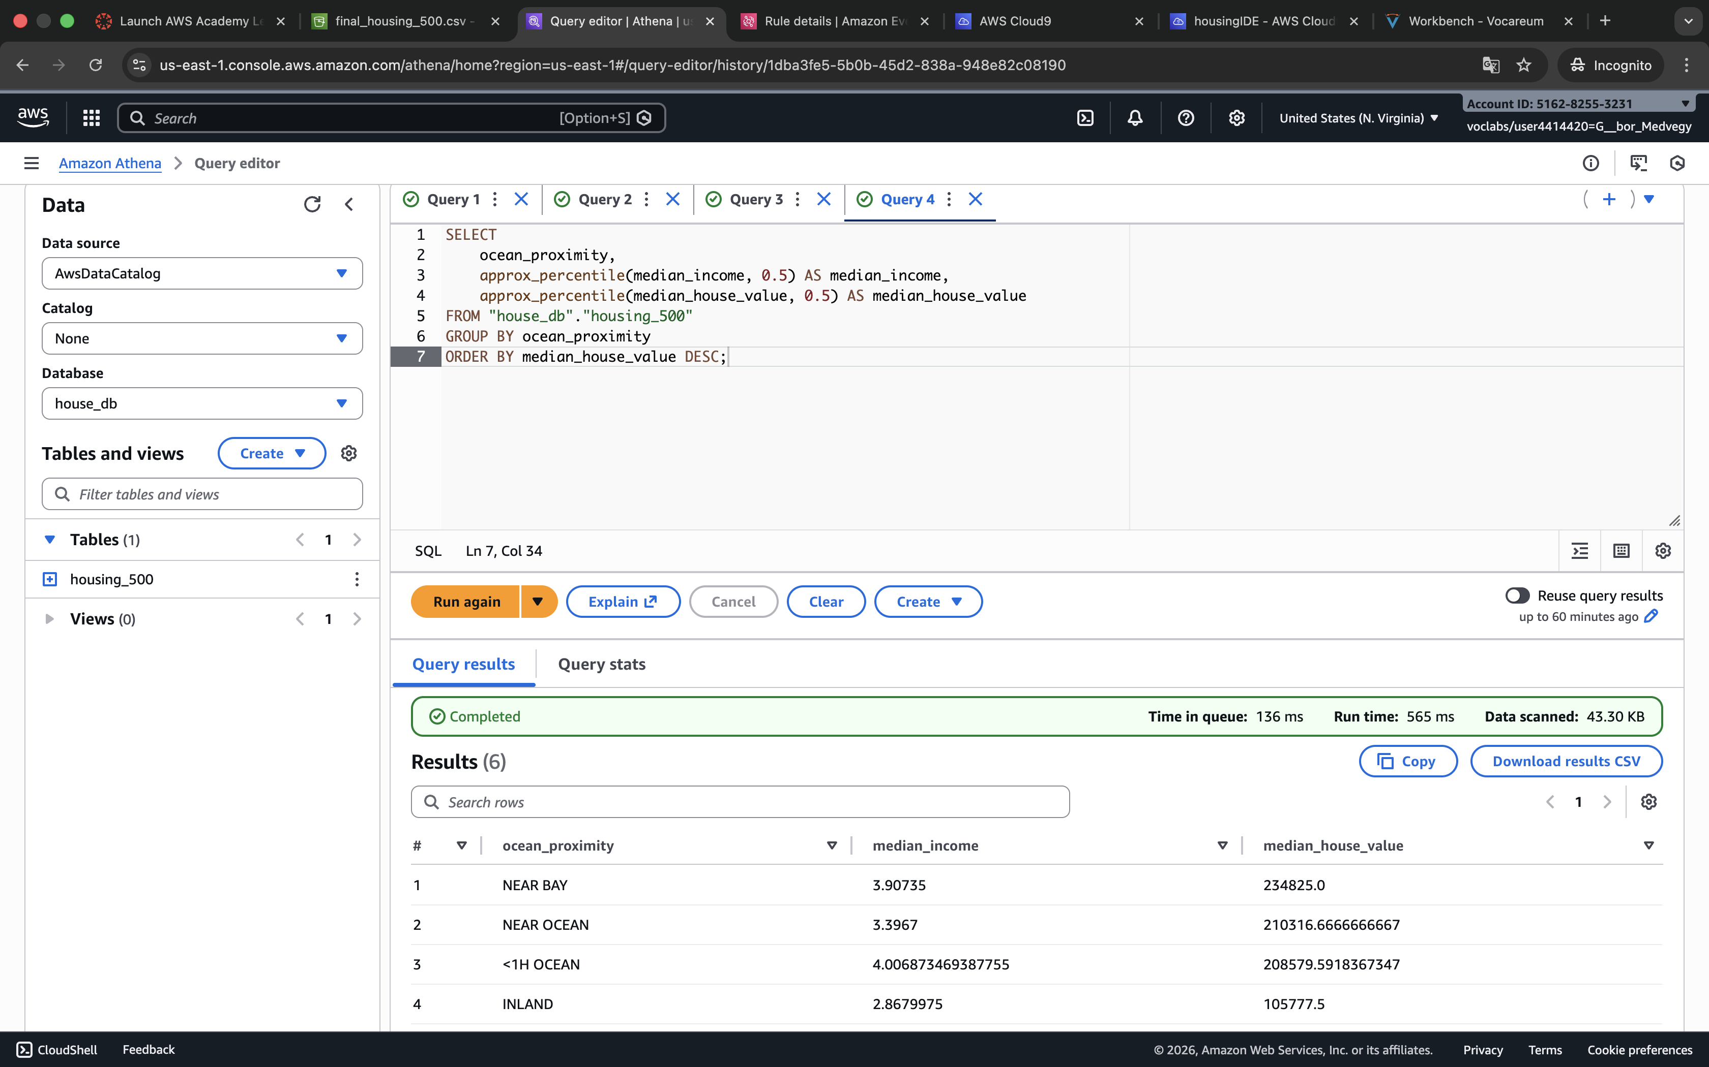
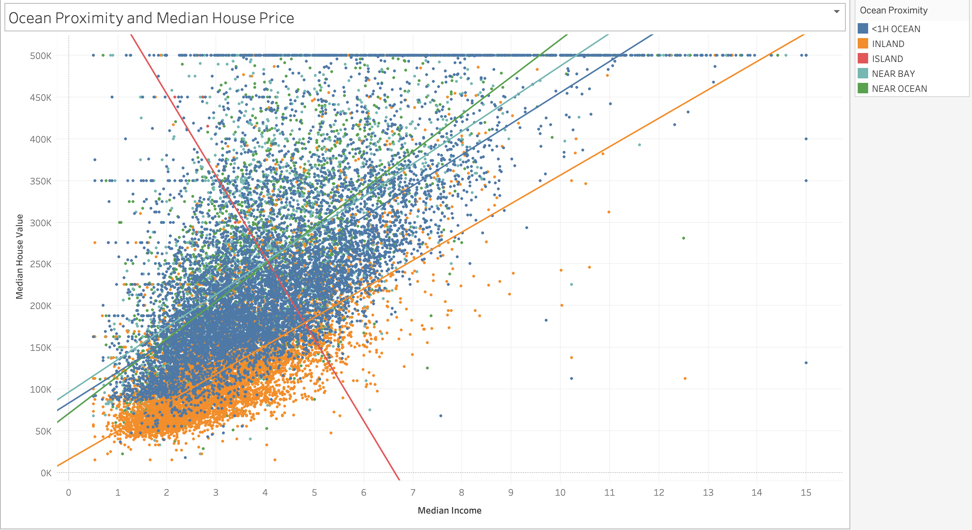
In Action

Slide 14
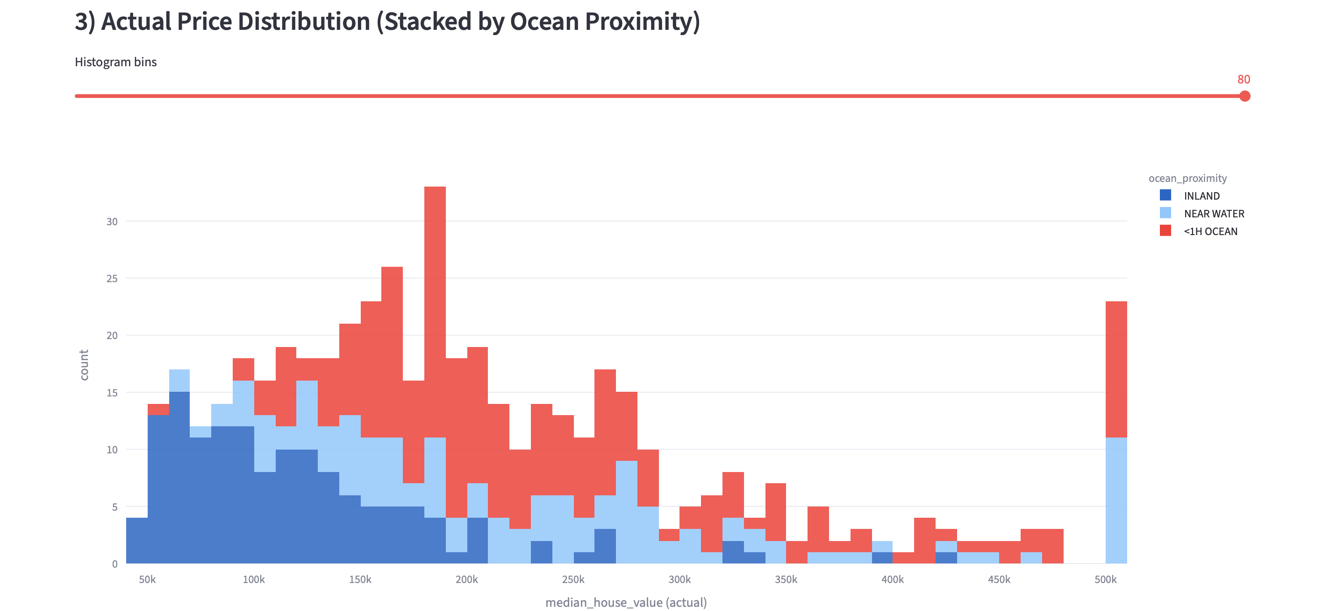
In Action

Slide 15
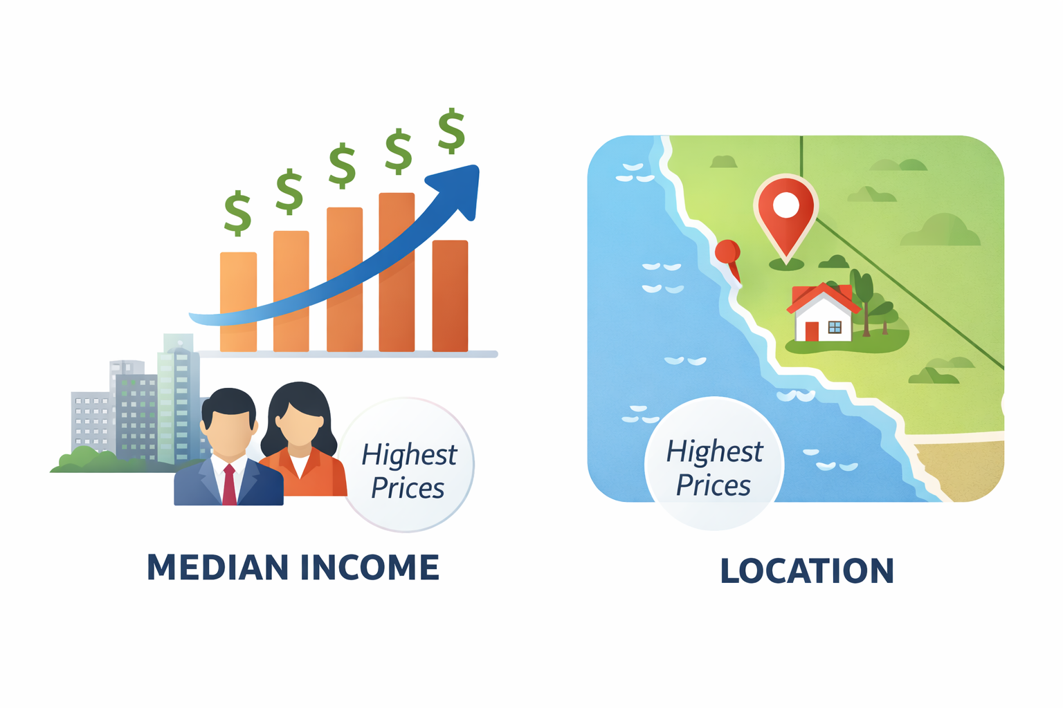
Results & Strongest Influences

Slide 16
Sources
Type | Source
California Housing Data | https://www.kaggle.com/datasets/camnugent/california-housing-prices
Weather Data | https://open-meteo.com
Cost Estimates | https://calculator.aws/#/
Charts & Images | https://gemini.google/hu/overview/image-generation/?hl=hu-HU

Slide 17
Thank you for your attention!
Questions?

